Slide 1
Rehabilitation for the Elderly
T60 – Group 1 – Q2e

Slide 2
THE PROBLEM

Slide 3
Challenges Faced
1 in 5 seniors (aged 60 and above) in Singapore experience chronic pain (Satghare et. al., 2016)
The lowest proportion of adults with regular exercise was observed among older adults aged 60 to 74 years (29.2%) (MOH, 2020)
The loss of mobility has physical, mental and emotional consequences, reducing their quality of life (Kabiri et. al., 2018)
The additional health complications creates a financial burden on the elderly and their families (Pike et. al., 2012)

Slide 4
How can we enable/encourage the elderly to undergo adequate rehabilitation in the face of its high cost?
Problem Statement
Action word
- Incentivise, motivate
-User-initiated
Focus area
- Cultivating habits
- Prevention and recovery
Context
- Financial cost
- Psychological barriers

Slide 5
Persona - Max
Retired Accountant, 65 years old
Sedentary lifestyle
- Accountant for 40 years
- Spends his time watching YouTube videos
Health Issues
- Knee pain
- Gets breathless easily
Goals
- Travel the world
- Spend time with grandchildren

Slide 6
THE SOLUTION

Slide 7
Aims & Objectives
The Health Promotion Board (HPB) recommends that seniors aged 50 years and above partake in:
Strength and balance exercises at least twice per week
150 minutes of moderate intensity exercise per week
(HPB, 2017)

Slide 8
Proposed Solution – Overview
Training Programme
Moderate-intensity:
Resistance exercises
Stretches for flexibility
Requirements:
Should be mentally engaging
Adjustable based on individual needs
(Gronek et. al., 2021)

Slide 9
Proposed Solution – Components
Supervised Training
Supervised by professionals or qualified volunteers
Optional
Initiation/refresher purposes
Unsupervised Training
Self-conducted or in groups, without external assistance
Key component

Slide 10
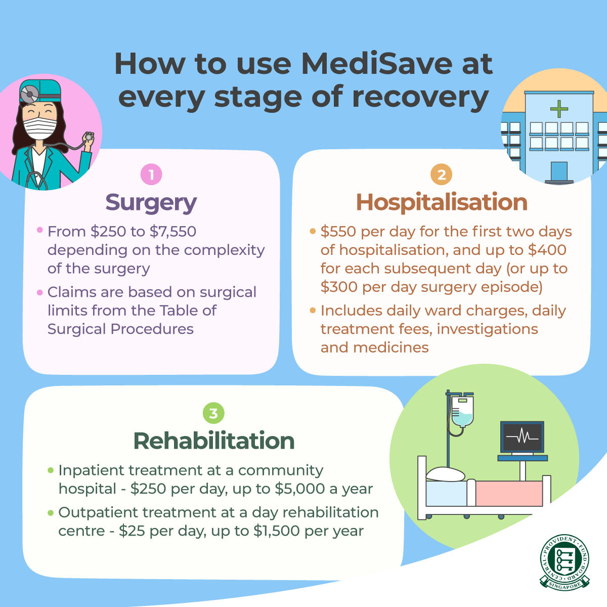
Tapping into Existing Programmes - Medisave

Slide 11
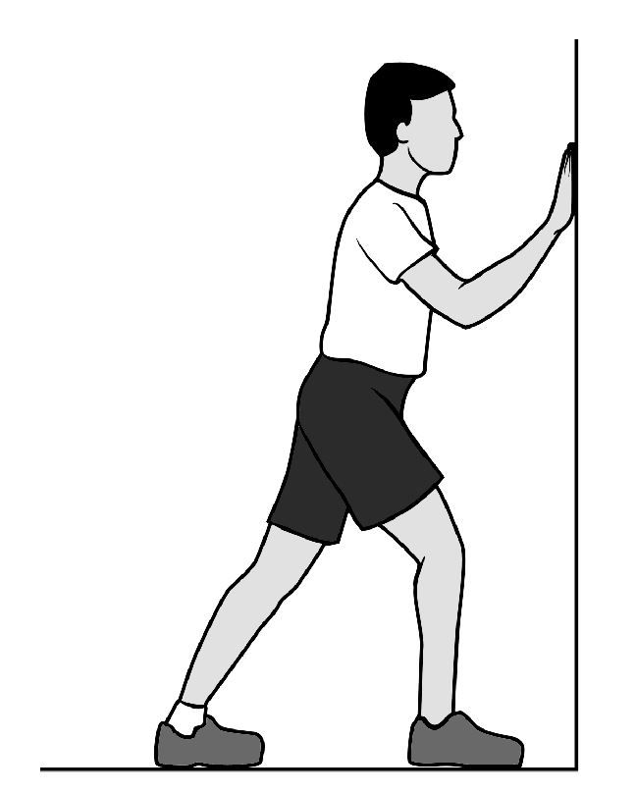
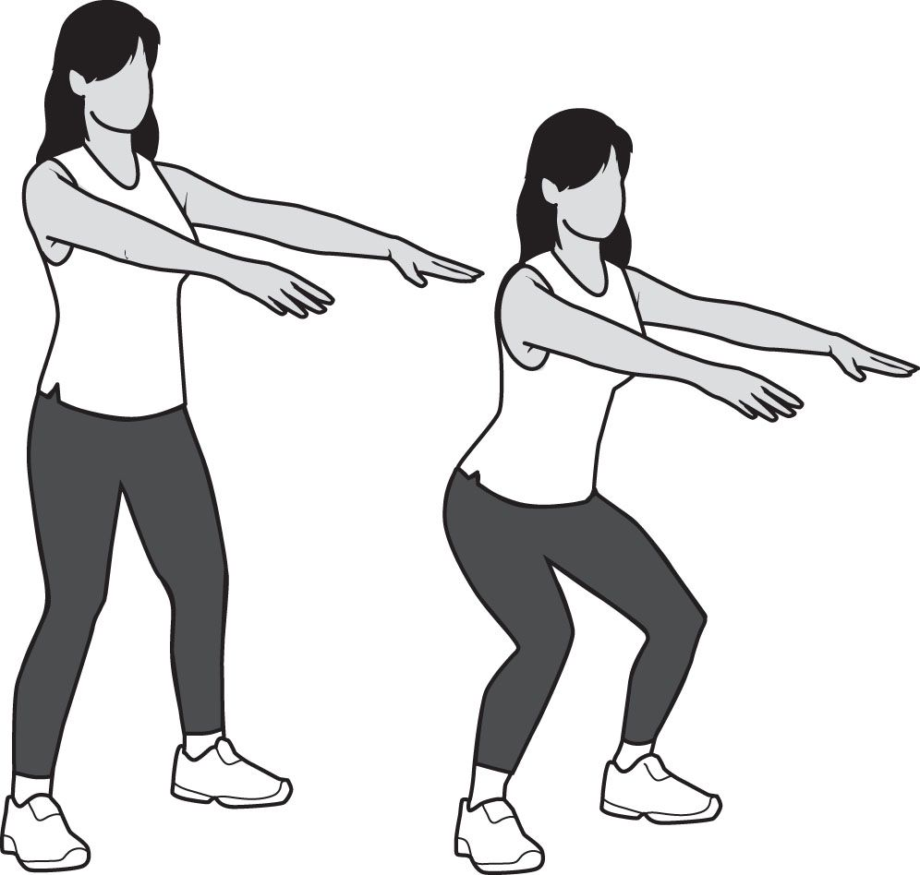
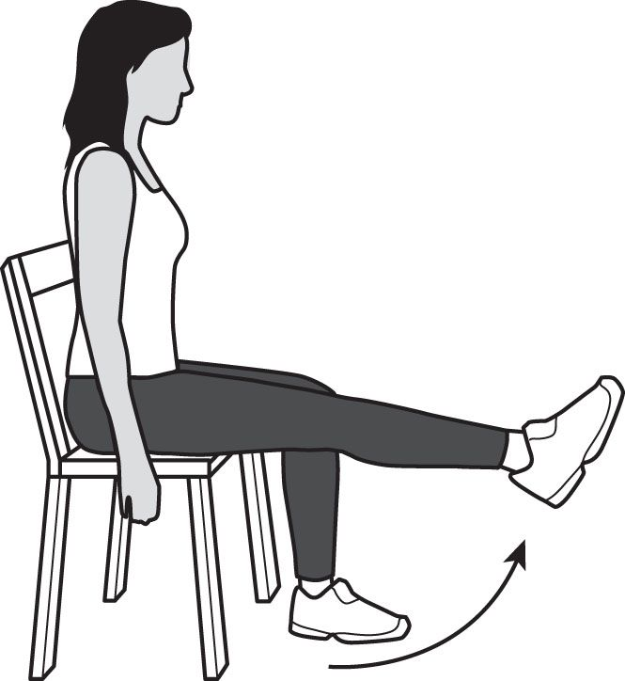
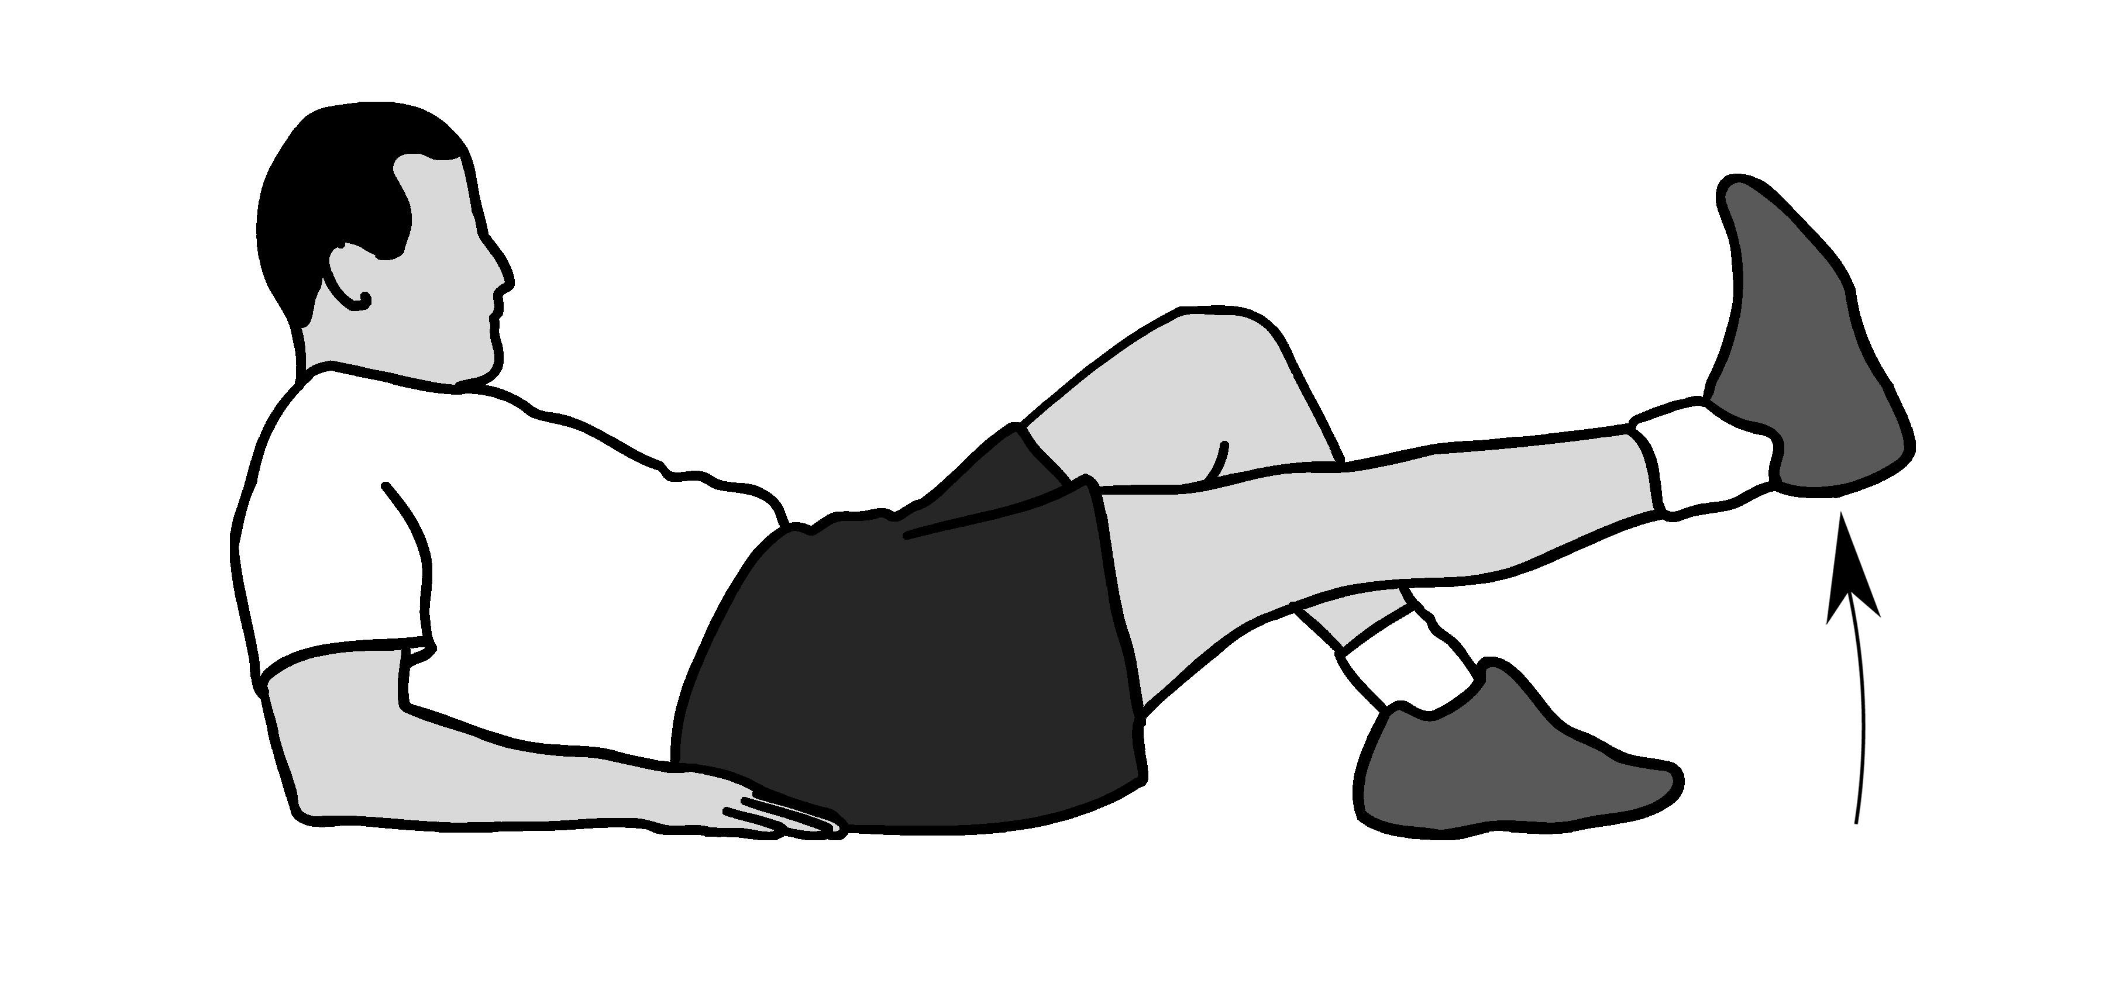
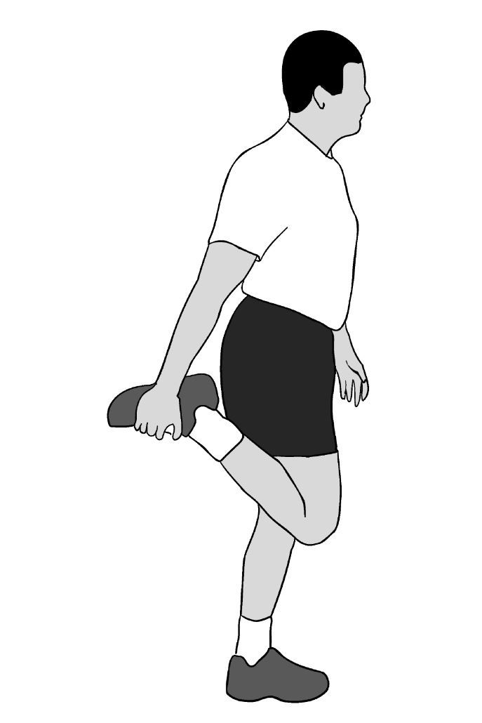
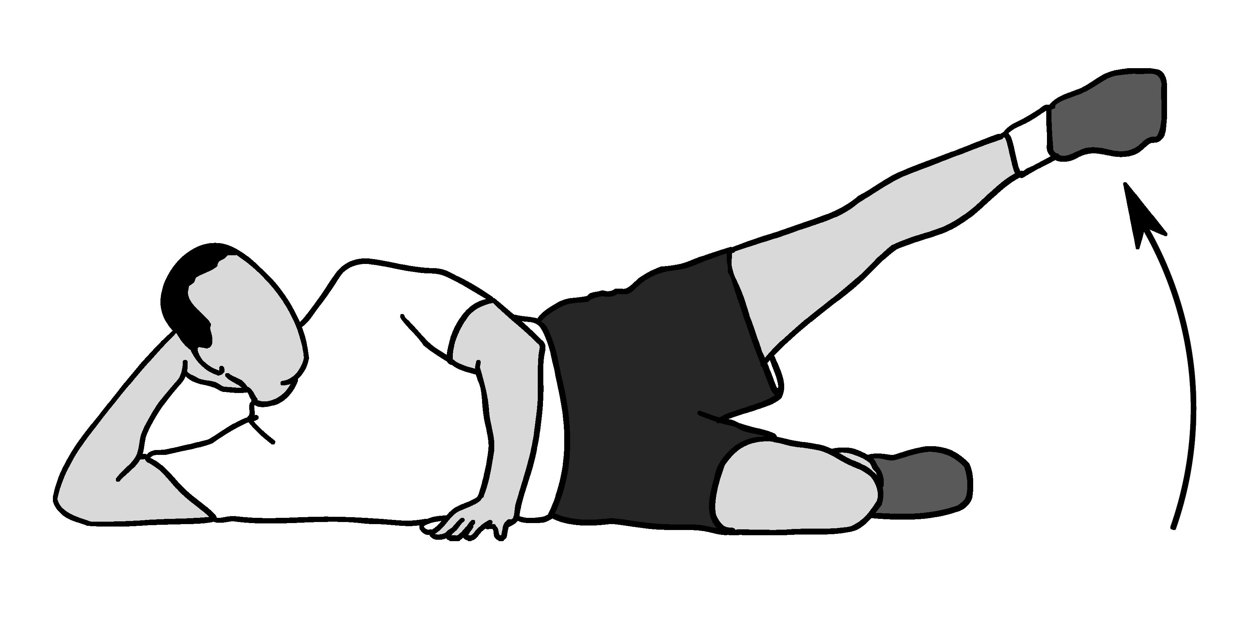
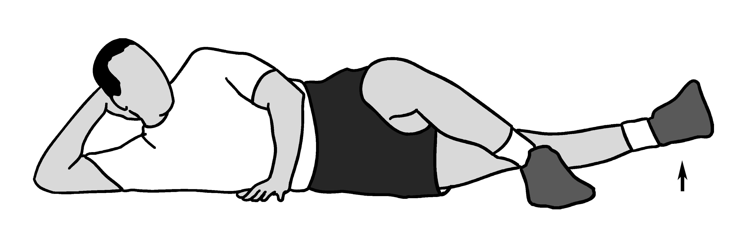
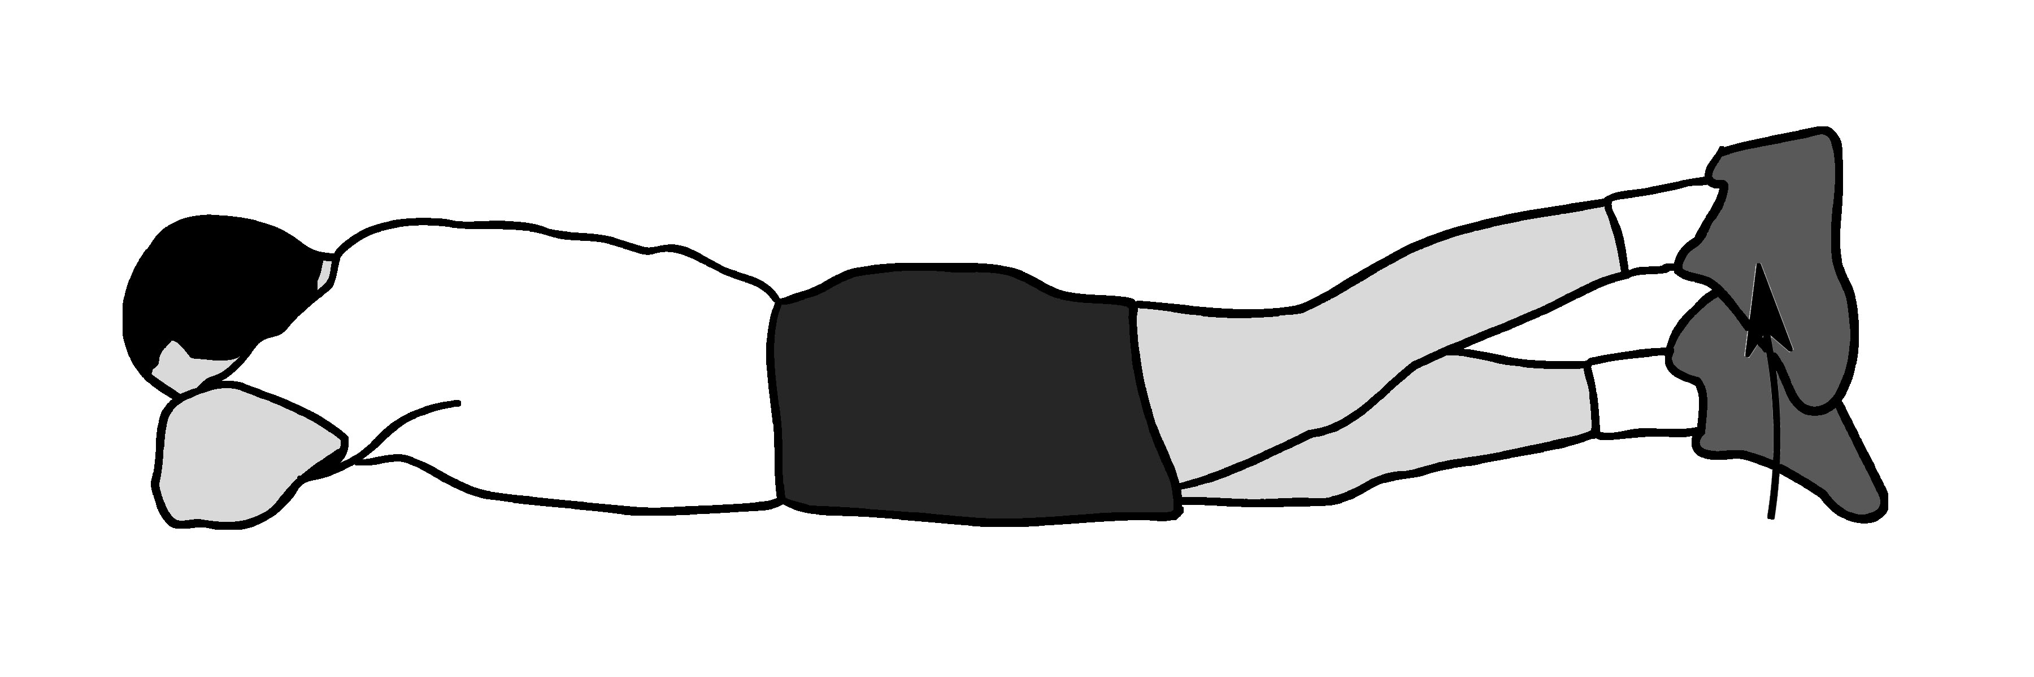
Rehabilitation Programme – Plan
Calf Stretch
Straight-Leg Raises
Half Squats
3x30s (per leg)
6-7 times per week
3x10 reps (per leg)
4-5 times per week
3x10 reps (per leg)
4-5 times per week
Quadriceps Stretch
Hip Abduction
Hip Extension
3x30s (per leg)
4-5 times per week
3x20 reps (per leg)
4-5 times per week
3x20 reps (per leg)
4-5 times per week
(OrthoInfo, 2018)

Slide 12
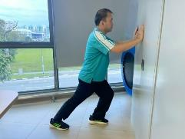
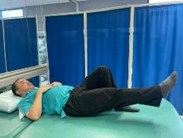
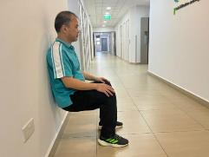
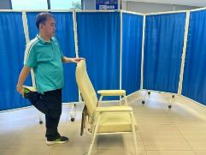
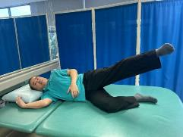
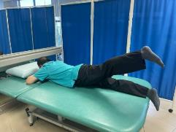
Rehabilitation Programme – Implementation
Government-provided or volunteer-initiated classes
Spread awareness through grassroots organisations, social services, etc.
(NTUC Health, 2023)

Slide 13
Programme Schedule
MON | TUE | WED | THU | FRI | SAT | SUN
Rehab | Flexibility | Aerobic | Rehab | Flexibility | Aerobic | Rest
HealthHub’s “Live Well, Age Well” Programme (HealthHub, 2023)
Aerobic | Flexibility/Control
KpopX Lite Line Dancing Zumba Gold Low Impact Aerobics | Taichi Yoga Qigong Pilates

Slide 14


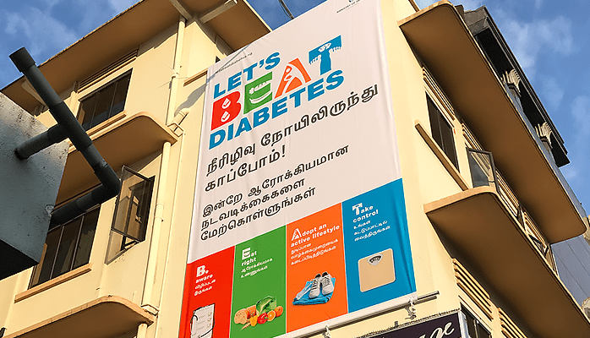
Features
Location
Hosted at Community Centres
Pricing
Option to use Medisave/CHAS card for payment
Ease of access
Exercises can be done alone and anywhere
Advertising
TV Advertisement and posters under HDB blocks

Slide 15

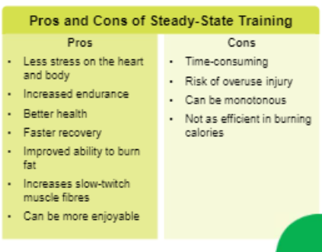



Short Run Outcome:
Strengths & Opportunities
Low Cost
Low barrier to entry
Utilises Existing Infrastructure
e.g. taps into Medisave, CHAS, HealthHub
Easily Customisable
Adjustable difficulty, flexible schedule to suit individual needs
Steady-State
Safe, low-intensity

Slide 16



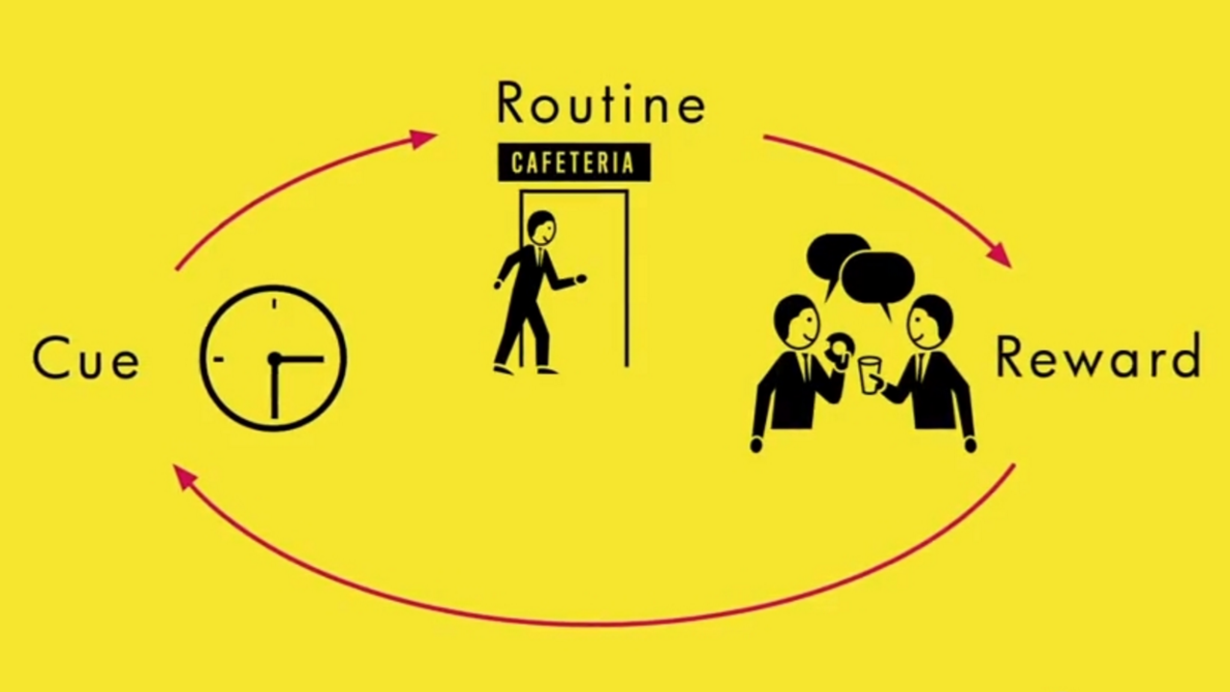
Short Run Outcome:
Strengths & Opportunities
Accessible
e.g. many easily accessible locations
Habit Stacking
e.g. habitually hanging out near community centers

Slide 17



Short Run Outcome:
Weaknesses & Threats
Interest and Motivation
Time consuming
Budget & Resources
Difficulty In Habit Formation
Awareness, organisation
Unreceptive to change
(HPBSG, 2017)

Slide 18
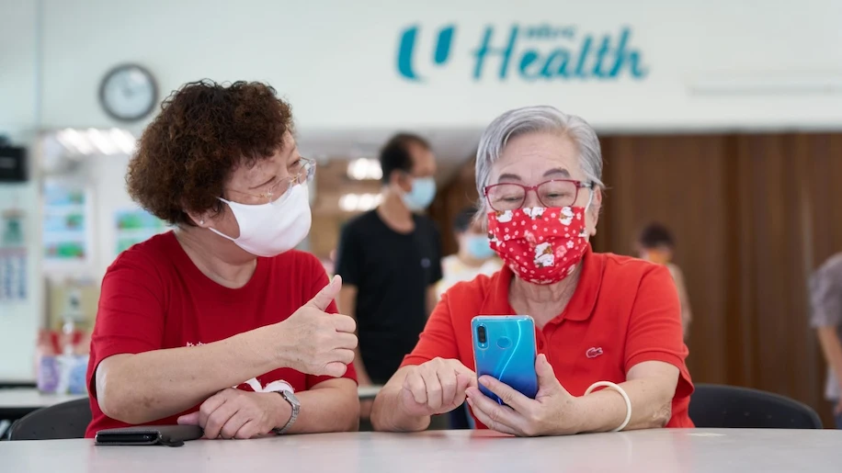


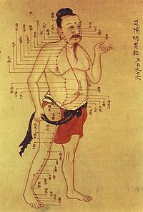

Short Run Outcome:
Weaknesses & Threats
Lack of inclusitivity
Not everyone has enough CPF
Lack of Digital Literacy
Limited means of raising publicity
Conflicting Values
Lack of trust in Western medicine

Slide 19



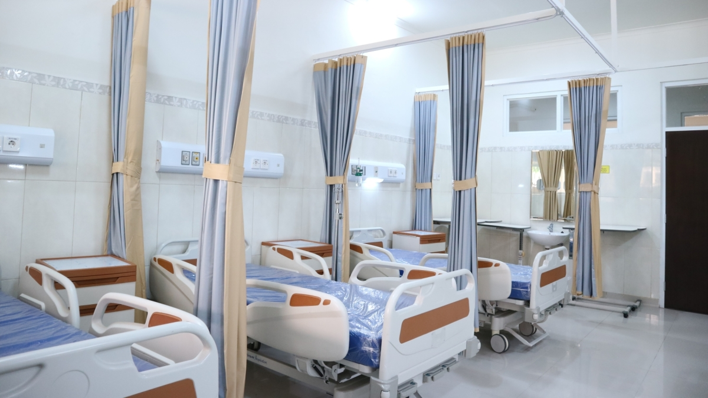

Long Run Outcome:
Strengths & Opportunities
Sustainability
Future-proof regiment
Positive Social Reinforcement
Mutual encouragement
Reduce Burden on Healthcase System
Early onset prevention

Slide 20


Long Run Outcome:
Strengths & Opportunities
Help Decrease DALYS
Improvement in ability to complete daily tasks
Low Personal Cost
Increases retention rate

Slide 21
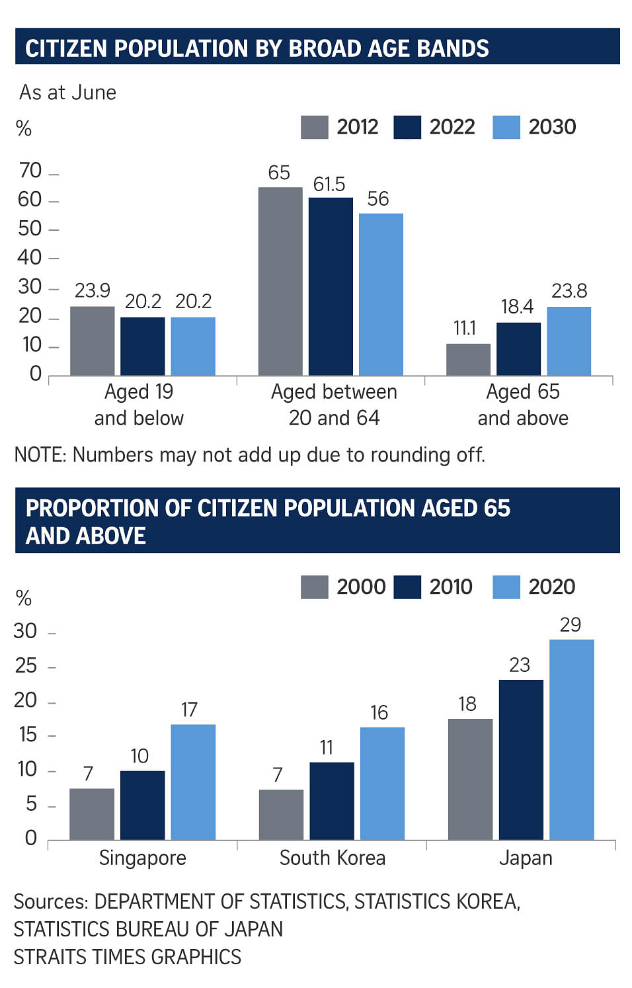



Long Run Outcome:
Weaknesses & Threats
User Customisation
Reliant on users to self-adjust based on their needs
Sustainability
Increasing cost due to aging population
Higher Risk Factor
During unsupervised exercise at home
(Chin, 2022)

Slide 22
Conclusion
User-Driven
Externally-Driven
User-driven and initiated
Sustainable, low-cost
Incentives and accessibility
Extra measures = extra cost

Slide 23
References (1)
CC Information. People’s Association. (n.d.). https://www.pa.gov.sg/our-network/community-clubs/cc-information/
Chin, S. F.. (2022, September 28). S’pore’s population ageing rapidly: Nearly 1 in 5 citizens is 65 years and older. The Straits Times. https://www.straitstimes.com/singapore/singapores-population-ageing-rapidly-184-of-citizens-are-65-years-and-older
Epidemiology & Disease Control Division and Policy, Research & Surveillance Group Ministry of Health and Health Promotion Board, Singapore. NATIONAL POPULATION HEALTH SURVEY 2020
Fig. 20.9 Singapore Master Plan 2014 showing the greenbelt and. . . (n.d.). ResearchGate. https://www.researchgate.net/figure/Singapore-Master-Plan-2014-showing-the-greenbelt-and-peripheral-industrial-zones_fig8_330963815
Gronek, J., Boraczyński, M., Gronek, P., Wieliński, D., Tarnas, J., Marszałek, S., & Tang, Y. Y. (2021). Exercise in Aging: Be Balanced. Aging and disease, 12(5), 1140–1149. https://doi.org/10.14336/AD.2021.0107
HealthHub. (2023). Live Well, Age Well Programme. https://www.healthhub.sg/programmes/aap?utm_source=google&amp;utm_medium=sem&amp;utm_campaign=fy23-hwp&amp;utm_content=sem-overview
Health Promotion Board (HPB). (2017, March 26). New exercise campaign to encourage active living among seniors, including those with reduced mobility. https://www.hpb.gov.sg/newsroom/article/new-exercise-campaign-to-encourage-active-living-among-seniors-including-those-with-reduced-mobility#:~:text=About%20the%20National%20Seniors’%20Health,well%2Dbeing%20and%20functional%20health.
Health Promotion Board. (2023, May 18). The Perfect Media. https://theperfectmediagroup.com/case-studies/health-promotion-board/
How to change your habits in three simple steps. (n.d.). https://www.ibmastery.com/blog/how-to-change-your-habits-in-three-simple-steps
HPBSG. (2017, October 26). You Can Get Moving - TVC (Mandarin version). Youtube. https://www.youtube.com/watch?v=3O7JnLHCjX4
Kabiri, M., Brauer, M., Shafrin, J., Sullivan, J., Gill, T. M., & Goldman, D. P. (2018). Long-term health and economic value of improved mobility among older adults in the United States. Value in Health, 21(7), 792–798. https://doi.org/10.1016/j.jval.2017.12.021
Lim, A. (2023, July 20). The average annual inflation rate in Singapore (2023). SmartWealth Singapore. https://smartwealth.sg/average-inflation-rate-singapore/
Ministry of Health (MOH). (2020). National Population Health Survey 2020. https://www.moh.gov.sg/docs/librariesprovider5/default-document-library/nphs-2020-survey-report.pdf
Mh&L. (2019, April 19). Can supply chains prepare for a recession? Material Handling and Logistics. https://www.mhlnews.com/global-supply-chain/article/22055574/can-supply-chains-prepare-for-a-recession
Nee-Soon South Community Centre – Sustainability Consultancy Firm. (n.d.). https://www.greenaconsultants.com/ourwork/nee-sooncc/
NTUC Health. (2023, August 31). Understanding osteoarthritis knee: Symptoms and treatments. NTUC Health Elderly Care. https://ntuchealth.sg/elderly-care/resources/health-and-wellness/understanding-osteoarthritis-knee-symptoms-and-treatments

Slide 24
References (2)
OrthoInfo. (2018, October). Knee conditioning program. https://orthoinfo.aaos.org/en/recovery/knee-conditioning-program/
Patrick Tay. Facebook. (n.d.). https://www.facebook.com/PatrickTayTG/posts/unused-medisave-amounts-in-cpf-accountsraised-this-as-a-parliamentary-question-d/679364327325870/
Ongweso, E., Jr. (2021, March 2). What Are SPACs, the Trend Blowing Up the Finance World? Vice. https://www.vice.com/en/article/4ade7b/what-are-spacs-the-trend-blowing-up-the-finance-world
Pike, J., Jones, E., Rajagopalan, K., Piercy, J., &amp; Anderson, P. (2012). Social and economic burden of walking and mobility problems in multiple sclerosis. BMC Neurology, 12(1). https://doi.org/10.1186/1471-2377-12-94
Reporter, S. (2023, October 3). SG adds around 500 beds to SG healthcare facilities, more expected by year-end. Singapore Business Review. https://sbr.com.sg/healthcare/news/sg-adds-around-500-beds-sg-healthcare-facilities-more-expected-year-end
Satghare, P., Chong, S. A., Vaingankar, J., Picco, L., Abdin, E., Chua, B. Y., & Subramaniam, M. (2016). Prevalence and Correlates of Pain in People Aged 60 Years and above in Singapore: Results from the WiSE Study. Pain research & management, 2016, 7852397. https://doi.org/10.1155/2016/7852397
Salzberg, S. (2013, February 11). Bad medicine infiltrates MD Anderson Cancer Center. Forbes.
https://www.forbes.com/sites/stevensalzberg/2013/02/11/bad-medicine-infiltrates-md-anderson-cancer-center/?sh=2341b114d2f3
Supporting seniors in going digital for life - Infocomm Media Development Authority. (n.d.). Infocomm Media Development Authority. https://www.imda.gov.sg/resources/blog/blog-articles/2021/03/supporting-seniors-in-going-digital-for-life
The Active Family Programme By HPB. (n.d.). The New Age Parents. https://thenewageparents.com/active-family-programme-by-hpb/
Villarba, J. (2023, November 8). How To Watch Friends Online From Anywhere in 2023. Bitcatcha - Web Hosting, VPN, Cloud Storage & More. https://www.bitcatcha.com/blog/how-to-watch-friends-online/

Slide 25
Thank you!

